Slide 1

Romance Scams
When Clients Face More Than Just a Broken Heart
Emily L. McDaniel, Esq.
emily@estatelawco.com

Slide 2
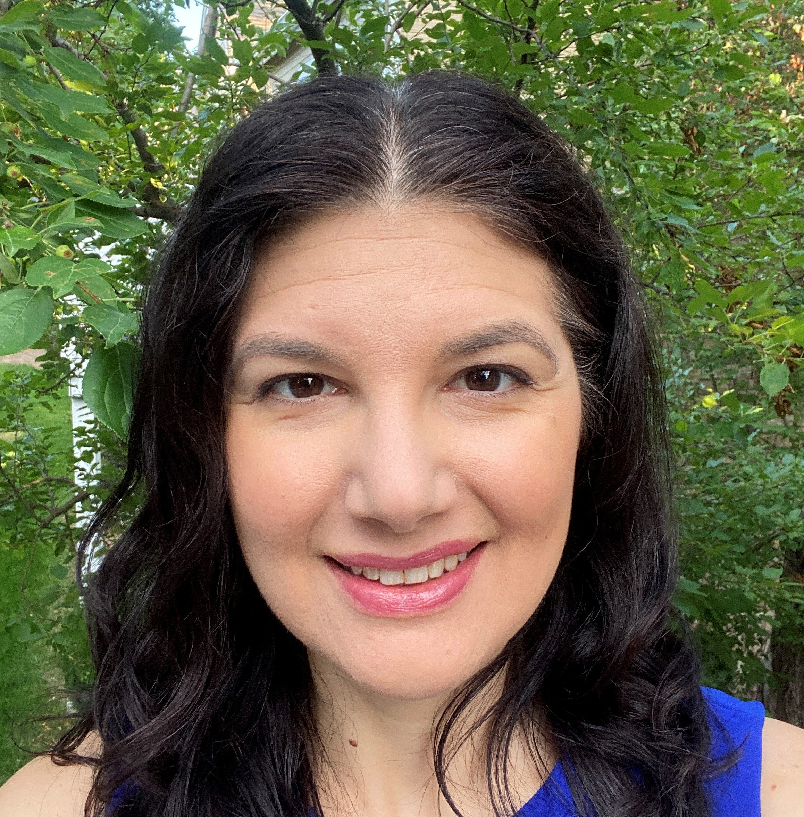
Hi, I’m Emily!
CBA Elder Law Section Chair (2023-2024)
Associate Attorney at Schwartz, McMinimee & Andrew, LLC since 2020
Support Public Administrator & 2 Deputy Public Administrators for the City & County of Denver
My focus: Conservatorships, Estate Administration, Trust Administration, Financial Investigations

Slide 3
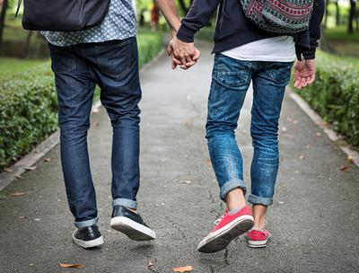
Agenda
What are Romance Scams?
Who falls for this & why?
Case Study 1: Edwin & Alice
Case Study 2: Molly & Carl
How can we help our clients avoid or recover from Romance Scams?
Resources

Slide 4


What is a Romance Scam, anyway?
There are many different flavors, but at the core a romance scam occurs when a criminal adopts a fake identity or persona to gain a victim’s affection and trust. The criminal then uses the illusion of a romantic or close relationship to manipulate and/or steal from the victim.
By the numbers…
64,003 reported romance scams in 2023
Total reported losses of $1.14 billion
Median loss per victim: $2,000
Highest rate of reported losses for any imposter scam
This Photo by Unknown Author is licensed under CC BY-NC

Slide 5
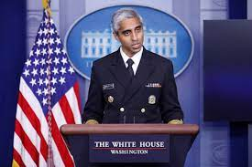

Why are people falling for Romance Scams?
Epidemic of loneliness
  27.6% of U.S. households are 1 person living alone
  Overall, 30% of U.S. adults are single (including 25% of men and 39% of women over age 65)
  Age 65+ is the fastest growing age cohort of victims
The human need to connect and be loved
Lack of familiarity & comfort with modern dating norms and technology
Love bombing: noun - the action or practice of lavishing someone with attention or affection, especially in order to influence or manipulate them.

Slide 6

Edwin & Alice
Case Study #1
This Photo by Unknown Author is licensed under CC BY

Slide 7
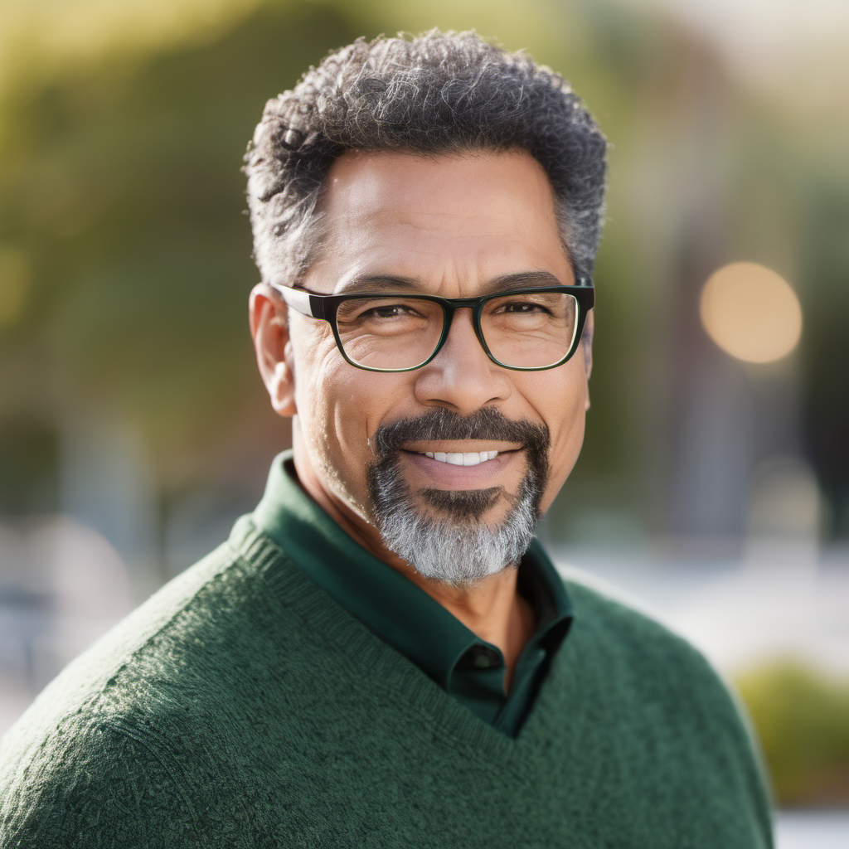
Hi, I’m Edwin!
Greetings from the stunning mountains of Colorado! I’m Edwin, a driven and accomplished guy who recently made the move to this breathtaking state in pursuit of a perfect work-life balance. With an Ivy League education and a successful career under my belt, I'm now ready to explore the possibilities of a meaningful connection.
Outdoor Enthusiast
The great outdoors is my sanctuary, and I find immense joy in exploring the mountains that surround me. Whether it's hiking a scenic trail, skiing down powdery slopes, or simply breathing in the crisp mountain air, I believe in living life to the fullest. If you share a love for outdoor adventures and appreciate the beauty of nature, we might just be the perfect match.
What I'm Looking For
I'm seeking a genuine and intelligent partner who shares a zest for life, appreciates ambition, and understands the importance of balance. If you're someone who values meaningful conversations, enjoys the outdoors, and is ready for a new chapter filled with laughter and shared experiences, I would love to get to know you better.
I believe in building a relationship based on trust, respect, and shared aspirations. If you're ready for a chapter of love, laughter, and exploration, let's connect and see where this exciting journey takes us!

Slide 8
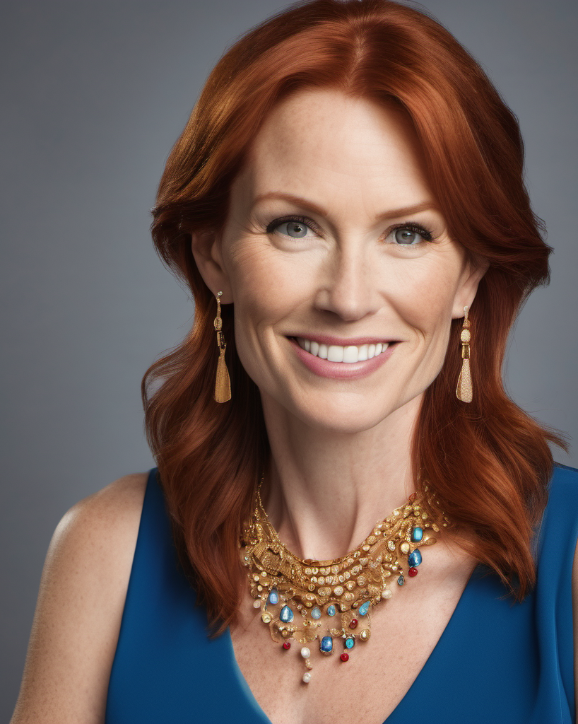
Hello, I’m Alice!
Hello there! I’m Alice, a resilient and warm-hearted woman who's ready to embrace the next chapter of life. I find joy in balancing my roles as a devoted single mother and a passionate entrepreneur. My teenage son is my world, and together, we make an unstoppable team navigating the beautiful journey of life.
I'm the proud owner of my own investing business, where I thrive on the excitement and challenges of the financial world. I love helping people secure their financial futures and achieve their dreams. It's a rewarding profession that aligns with my ambition and determination.
A new chapter awaits us as we plan to move to the breathtaking city of Colorado Springs. The mountains, the outdoor activities, and the vibrant community have captured our hearts. If you're someone who enjoys hiking, exploring new places, and appreciates the beauty of nature, I can't wait to share these experiences with you.
What I'm Looking For:
I’m looking for someone who appreciates the complexities of life, values family, and shares a passion for personal and professional growth. If you're someone who believes in open communication, mutual support, and is ready to embark on a new chapter with a loving family, then I'd love to get to know you better.

Slide 9
What concerns or issues does Alice & Edwin’s story raise for you?
Never met in person, Alice cancels every phone/video call they schedule
Alice moved the conversation to WhatsApp and has created a false sense of intimacy & closeness through text/chat communication
Alice is abroad with constant troubles
Alice is “love bombing” Edwin and manipulating him – “ I have an emergency, and you’re the only one who can help me,” “You’re the only person I can trust.” etc.
Alice’s son to asks Edwin to help so his mom can come home
Cryptocurrency (Bitcoin) sales and wire transfers to bank accounts abroad
Edwin’s name & SSN is on the bank account and the Coinbase account
Alice begs Edwin not to discuss their transactions with any of his friends because they won’t understand…

Slide 10
Edwin is our client – what legal issues is he facing?
Criminal issues:
Money Laundering (18 U.S.C. § 1957; § 18-5-309, C.R.S.)
Bank Fraud (18 U.S.C. § 1344; § 18-5-205, C.R.S.)
Wire Fraud (18 U.S.C. § 1343; § 18-5-308, C.R.S.)
Mail fraud (18 U.S.C. § 1341)
Identity Theft (18 U.S.C. § 1028; § 18-5-902, C.R.S.)
Accessory or Accomplice Liability for any of the above
Civil/other issues:
Dumped by banks for suspicious activity
Tax implications of the Bitcoin sales and funds transfers

Slide 11

Molly & Carl
Case Study #2

Slide 12

The things Molly will do for love…
New Powers of Attorney
Reverse Mortgage
Credit Cards
A home for Carl
Property interests deeded to Carl
Beneficiary deeds naming Carl to receive remainder interests in Molly’s properties
New Will naming Carl as majority beneficiary of Estate
Withdrawing retirement funds for Carl’s friend, Tom
Leave Colorado to make this go away for Carl

Slide 13
Molly is our client - what concerns or issues do you have for her?
Legal, Financial & Practical issues:
Severely reduced liquid funds
Scammed funds unlikely to be recovered
Insufficient monthly income to cover care & carrying costs of 3 real properties
Underwater reverse mortgage
Property co-ownership with Carl
Credit card debt
Significant federal & state income tax debt from realized retirement income
Won’t qualify for Medicaid LTC benefits without long penalty period

Slide 14

A note about AI…

Slide 15
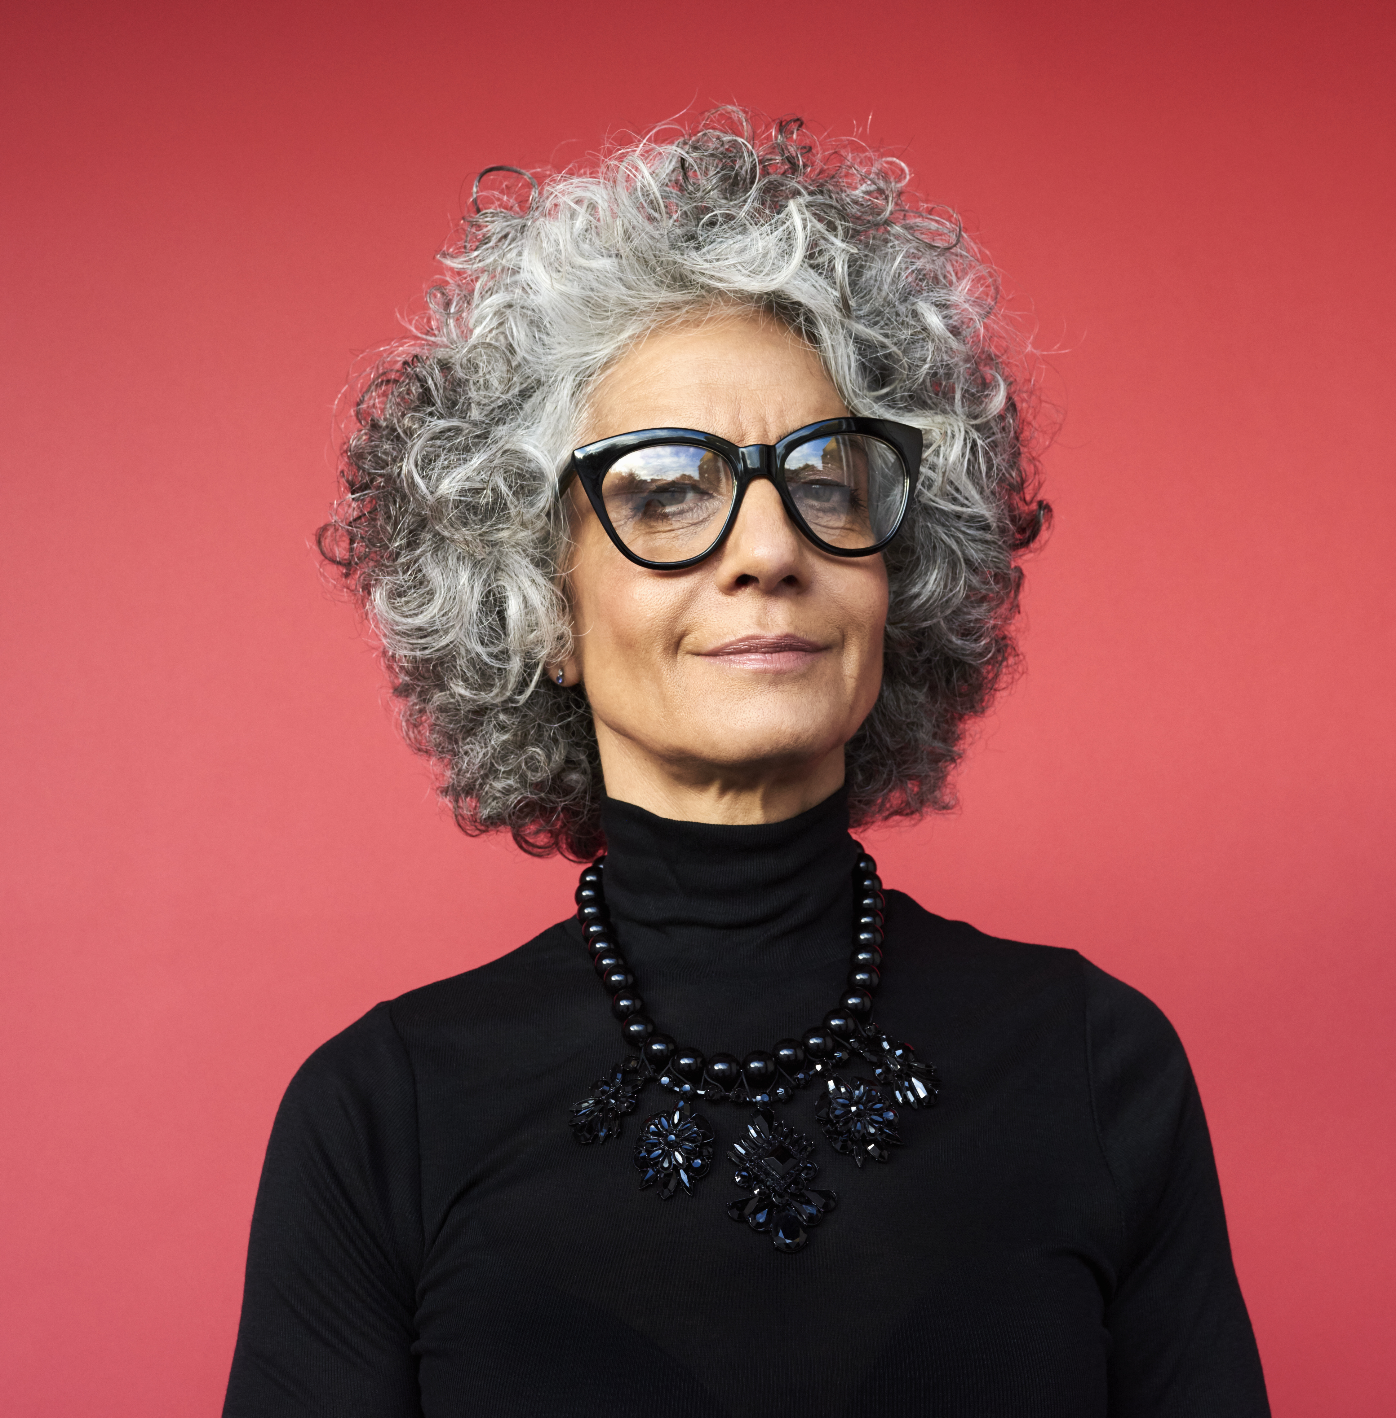
How can we help our clients?
Empathetic listening
Research (Meet?) the love interest
Reverse image search
Encourage in-person meetings
Stop the financial bleeding
Report to law enforcement

Slide 16
Theories of Recovery Defenses
Conversion
Civil Theft
Fraud
Undue Influence
Breach of fiduciary duty
Replevin
Constructive Trust
Consent
Gift
Key: Personal jurisdiction over the perpetrator

Slide 17
Resources (see outline for links)
Consumer
Government
Better Business Bureau
Fraud.org
Credit freeze via Reporting & Monitoring Agencies
Therapy
Matchmakers & Dating Coaches
Federal Trade Commission
FBI
Internet Crime Complaint Center
Stop Fraud Colorado
District Attorney’s office

Slide 18

Questions?
Thanks – I love you guys!
Emily L. McDaniel, Esq.
emily@estatelawco.com

